Slide 1

Welcome to Key Stage 1
2026-2027

Slide 2
Aims of the meeting:
- for you to meet the teaching staff in Key Stage 1 and for us to meet you.
- to outline how Key Stage 1 is organised.
- to find out about key assessments your children will complete within the Key Stage.

Slide 3
Staff in Key Stage 1:
Mrs Davies
Key Stage 1 Phase Leader
Year 1 Teacher
Mrs Mantle-Taylor
Outdoor Learning Lead
Year 2 Teacher
Miss Bateman
Year 2 Teacher
Support Staff:
Mrs Andrews

Slide 4

How to communicate with the KS1 Staff
- School Website – Class Pages
- Class Dojo – Class Page and KS1 Page
- Informal chats at home time
- Please make an appointment for more important issues
- Phone school office
- Parents meetings
Class Teacher – Phase Leader - Headteacher

Slide 5

Main differences between Foundation Stage and KS1
- More structured lessons – progression throughout the year
- Daily phonics, maths and writing sessions
- More whole class learning – short bursts
- A greater focus on children working independently
- Use of “play based” learning to develop curiosity and independence.
- Year 2 the level of independence increases further

Slide 6

Children will predominantly be taught by their class teacher in their classroom.
Some subjects will be taught by different teachers – using our expertise, strengths and interests.
Mornings will be focused on Phonics, Reading, Maths and Writing.
Afternoons will be more focused on the Foundation subjects – Geography, History, RE, Science, Music, Art, Design and Technology

Slide 7
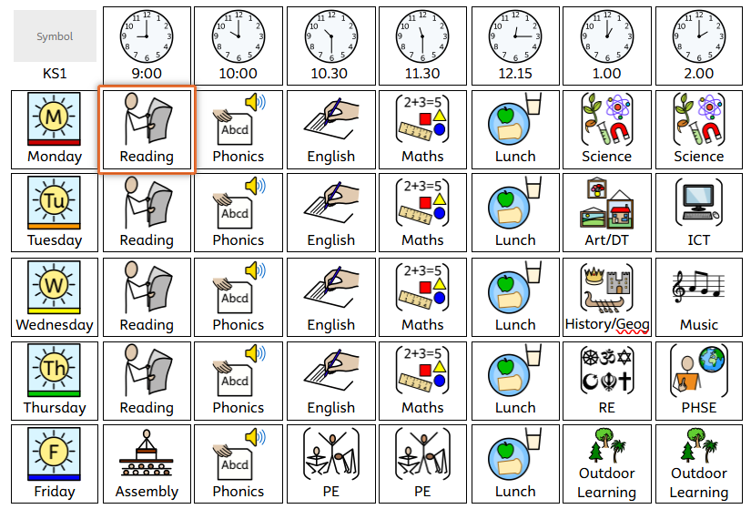
Example Timetable

Slide 8
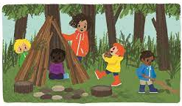
Forest School/Outdoor Learning
Your child will have Forest School/Outdoor Learning every Friday this year.
They will need a pair of wellies and waterproofs each Friday.
Friday will also be our PE day. Children can come to school in their PE kits on a Friday.
Forest School Evening – During the Summer Term, Year 1 and 2 come back to school for some Forest School fun. Year 2 spend the night at school!

Slide 9
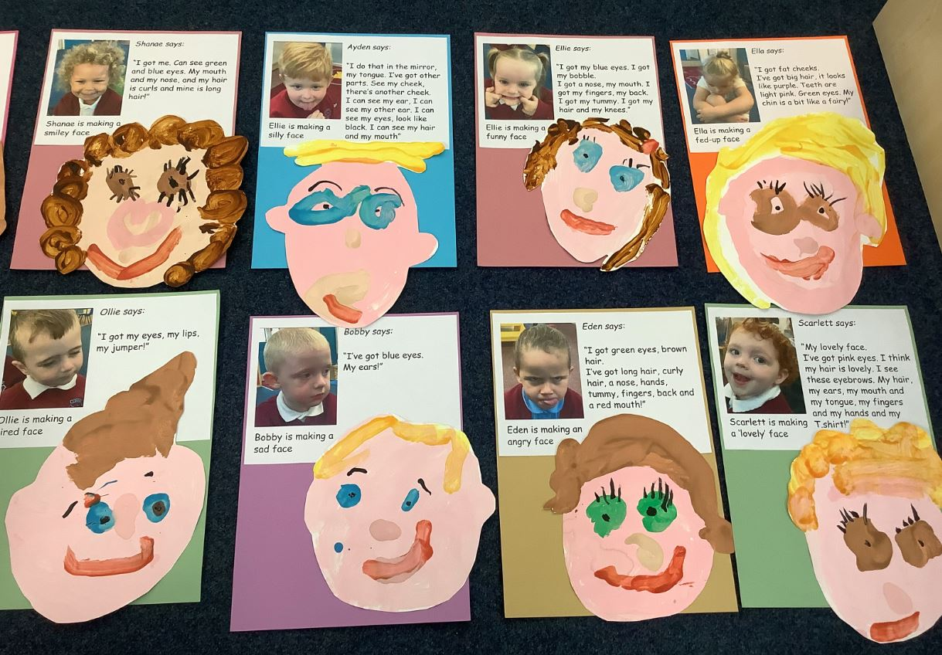
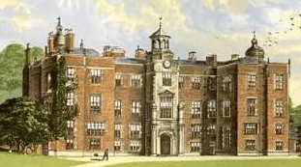

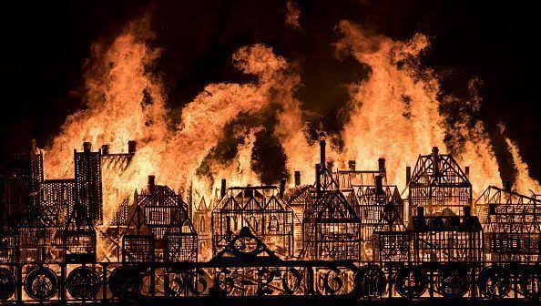
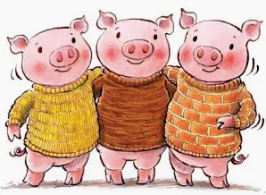

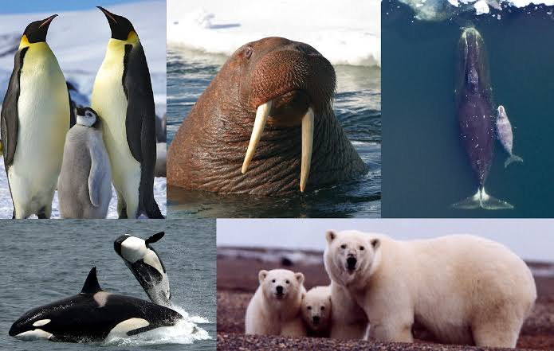
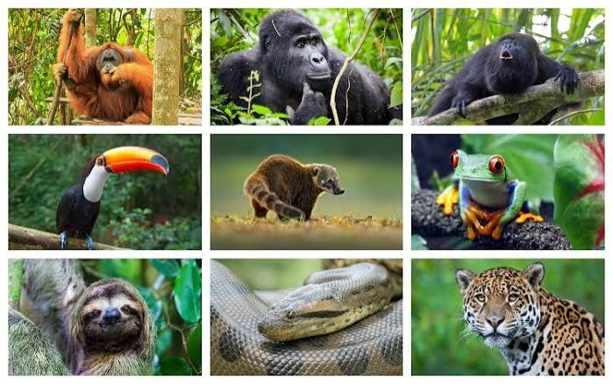


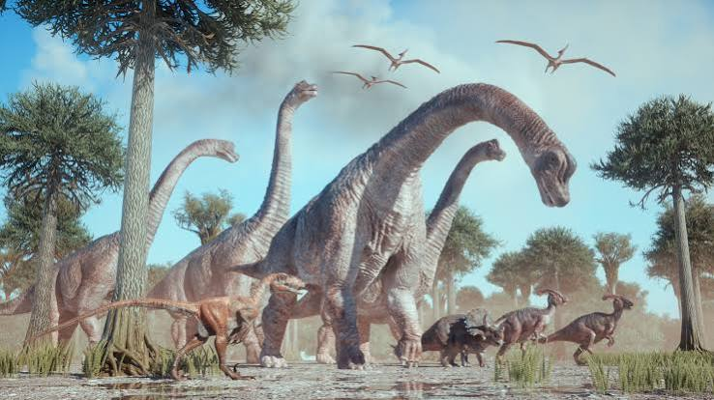
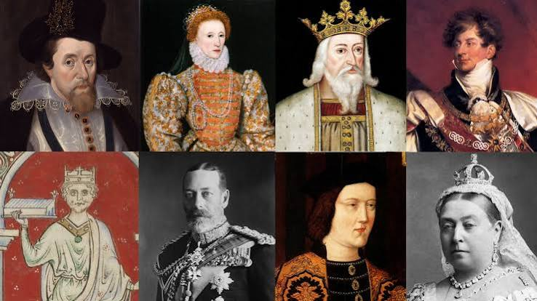
Learning in Year 1 and 2
As we move to a 1 form entry school, the children will cover different topics in Year 1 and 2.
Year 1 Learning
Autumn 1 – Uniquely Me!
Autumn 2 – Memory Box
Spring 1 – Huff Puff and Build it Tough
Spring 2 – Polar Explorers
Summer 1 – Bugs and Buds
Summer 2 – Dinosaur Planet
Year 2 Learning
Autumn 1 – Uniquely Me!
Autumn 2 – Fire! Fire!
Spring 1 – In Outer Space
Spring 2 – Jungle Explorers
Summer 1 – Microhabitats
Summer 2 – Kings and Queens

Slide 10
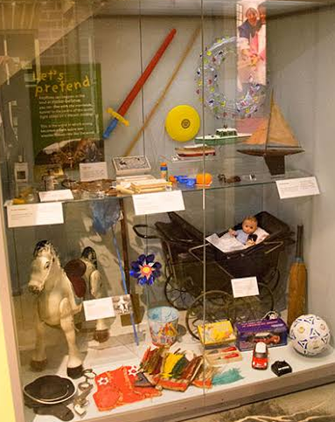
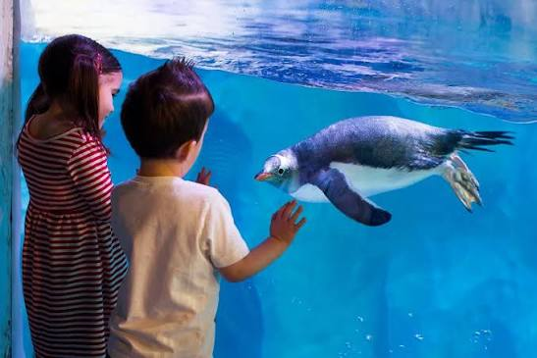

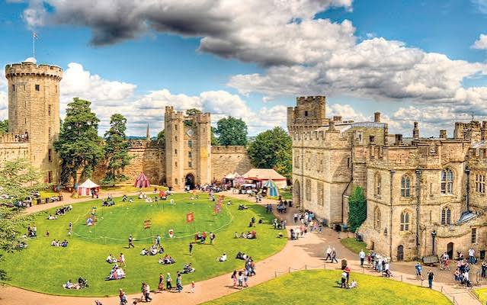
Possible Trips and Visitors
Year 1:
- Autumn 1 – Nurse Visit
- Autumn 2 –Toy Museum Visit
- Spring 2 – National SeaLife Centre Birmingham
- Summer 1 – Wolseley Centre Visitors into school
- Summer 2 – Dinosaur Workshop in school
Year 2
- Autumn 1 – Walk around the local area
- Autumn 2 – Great Fire of London in school workshop/trip to local fire
station
- Spring 1 –Visit to Leicester Space Centre
- Summer 1 - Wolseley Centre Visitors into school
- Summer 2 – Visit to Warwick/Tamworth Castle

Slide 11


Home Reading
We send 2 different types of books home from school:
- an eBook. This book is closely matched to your child’s
phonic ability. It is the same book that they are reading with us in school.
This book will be sent home electronically once a week. It can be accessed by the Big Cat Collins website.
- A Fantastic 50 Book. This is not linked to their reading ability and the children choose it because they like the look of it and want to read it for pleasure.

Slide 12
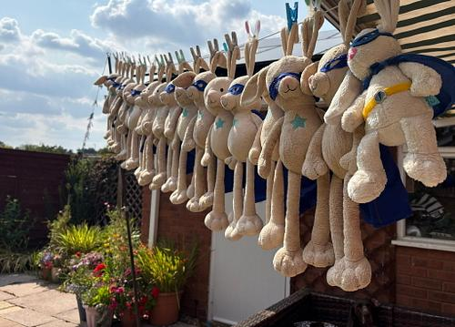
Your class teacher will let you know via Dojo which
days the books will be sent home and on which days
they need to be returned.
The class Reading Rabbit will come home with the “Reader of the Week” each Friday.

Slide 13

Rewards:
- Dojo Monster Points. These are awarded by school staff
for a range of different skills. It is an electronic system that tracks the number of points your child earns.
- TORCH Award. Children who demonstrate one of our TORCH values will be awarded a certificate by Mrs O’Hare in a whole school assembly. You will be invited to the assembly.
- Photographs home of a piece of work either we are really proud of or your child is really proud of.

Slide 14
Parents Meetings
Year 1 Phonics Meeting – Early October. Date to be confirmed.
6.00pm - 7.00pm (parents only)
Key Stage 1 Maths Workshops – November. Date to be arranged.
Parent Consultation Meetings –
- November 4th
- February 24th
Please do not hesitate to contact us at any time if you have any concerns regarding your child’s learning or progress.

Slide 15
Expectations
- Please label all your child’s school clothes.
- Send a water bottle every day
- Appropriate clothes for the weather – sunhat/cap, coat
- Send school Fantastic 50 book back to school every week.
- Wear appropriate school PE kit every FRIDAY – The children will have indoor and outdoor PE on this day so please put PE shorts underneath jogging bottoms.

Slide 16

Snack
At Holly Grove, we encourage children to develop healthy eating habits that support their learning, concentration and wellbeing. The proposed updated School Food Standards place greater emphasis on increasing fibre through fruit, vegetables and wholegrain foods whilst reducing sugar and foods high in fat, sugar and salt.
We encourage children to bring:
✅ Fresh fruit (apples, bananas, oranges, grapes, pears, berries)
✅ Vegetables (carrot sticks, cucumber sticks, pepper strips)
We also have a range of free fruit available in school each
day for the children to choose from.

Slide 17
Donations for topic days in school
Throughout the year we will have topic days and activities to enhance the curriculum eg;
- Family Christmas Craft morning
- making fruit and vegetable salads linked to Design and Technology
To help cover the costs of materials for these days, we may ask for a small donation. We will let you know at the start of each half term if we are planning any of these activities and a suggested donation amount. It will be not more than £3.00 per child.

Slide 18
Assessments in Key Stage 1
In school assessments:
- Year 1 Spring and Summer Term NFER Maths and Reading Assessments. Used to inform our teaching within school.
- Year 2 Assessments for Reading, Writing, Maths and Spelling, Punctuation and Grammar (SPAG).
Statutory Assessments in Key Stage 1
Year 1 Phonic Screening Test –It usually happens around June 8th each year. This is a National Test and results are reported to the Department of Education. We will be holding another Parents Meeting for this later in the term.

Slide 19
Volunteering in school
We would love your help with:
📚 Listening to children read and supporting literacy activities
🎨 Assisting with art, craft and creative projects
🧮 Supporting practical classroom activities and learning experiences
🌱 Helping with gardening, outdoor learning and environmental projects
🚌 Accompanying educational visits and school trips
🎭 Supporting performances, celebrations and special events
👩‍⚕️ Sharing your skills, hobbies, experiences or career with our children
Interested in volunteering?
We warmly welcome volunteers into our school community. To ensure that all children remain safe, all volunteers must complete our safeguarding procedures before working with pupils. This includes:
✅ Completing safeguarding and child protection training
✅ Reading and understanding key safeguarding guidance and school procedures
✅ Undertaking the necessary pre-volunteering checks, including obtaining an Enhanced DBS (Disclosure and Barring Service) check where required
✅ Following the school's safeguarding, confidentiality and volunteer expectations
Our staff will guide and support you through this process and provide any training required.
Why volunteer?
• Help children build confidence and develop a love of learning
• Gain an insight into life at Holly Grove
• Support our wider school community
• Make a positive difference to children's experiences and opportunities
Every Helping Hand Matters
"Together, we can provide even more opportunities for our children to learn, thrive and succeed."
If you would like to volunteer, please speak to your child's class teacher or contact the school office. We'd love to hear from you!

Slide 20
Thank you all for coming.
The Key Stage 1 Team

